Slide 1
How Does a Bike-Share Navigate Speedy Success?
Pawin Urapevatcharewan
December 2021

Slide 2

Cyclistic is a bike-share company in Chicago. The the company features more than 6,000 bicycles and 600 docking stations. Cyclistic sets itself apart by also offering bikes, hand tricycles, and cargo bikes, making bike-share more inclusive to people with disabilities and riders who can’t use a standard two-wheeled bike.

Slide 3
Objectives
Covert and increase subscriber member

Slide 4
Customer types
Casual customer
Customer who purchases Single Ride Pass.
- $3.30 for single 30-minute ride.
Customer who purchases Day Use Pass.
- $15 per day. Unlimited ride in 24 hours, up to 3 hours per ride.
Subscriber customer
Customer who purchase membership
-$9 per month. Unlimited ride up to 45 minutes ride
-$108 billed upfront annually
*The fee for a lost or stolen bike is $1200.

Slide 5
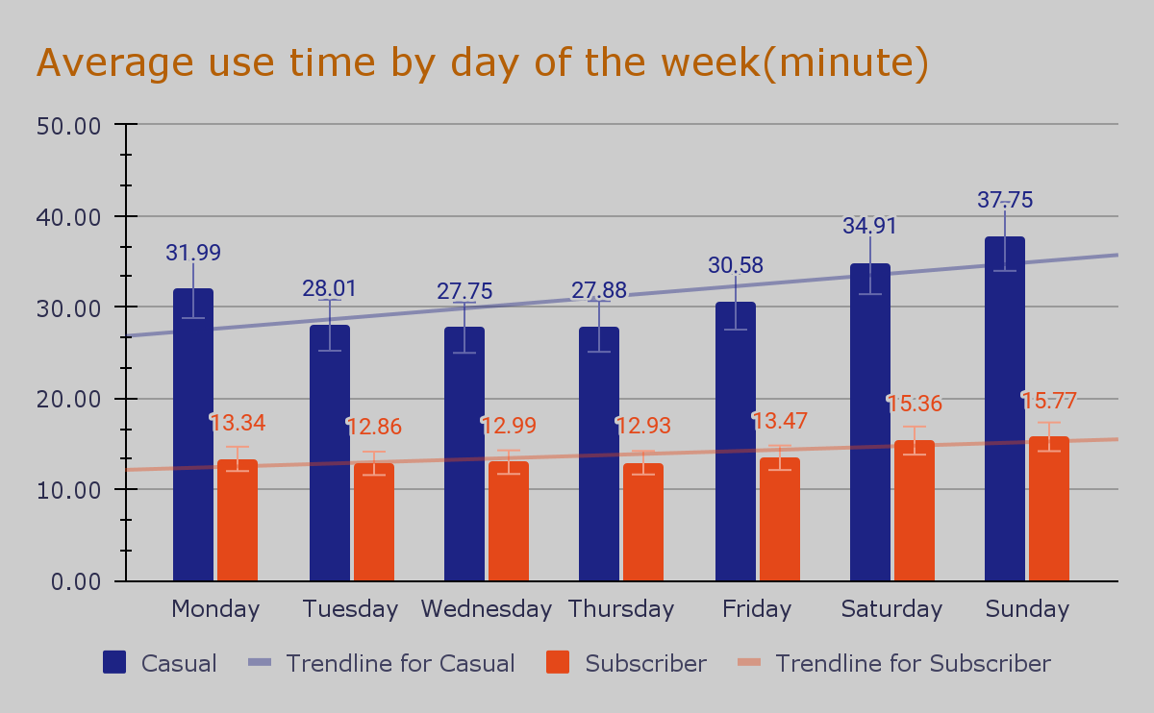
Day of the week analysis
Casual customers’ ride lengths are significantly longer.
Subscriber customers’ ride lengths on the weekday are stagnant. However, at the
weekend ride lengths are slightly increase
The average time used by the casual customer is 31.2 minutes, subscriber customer is 13.8 minutes.

Slide 6
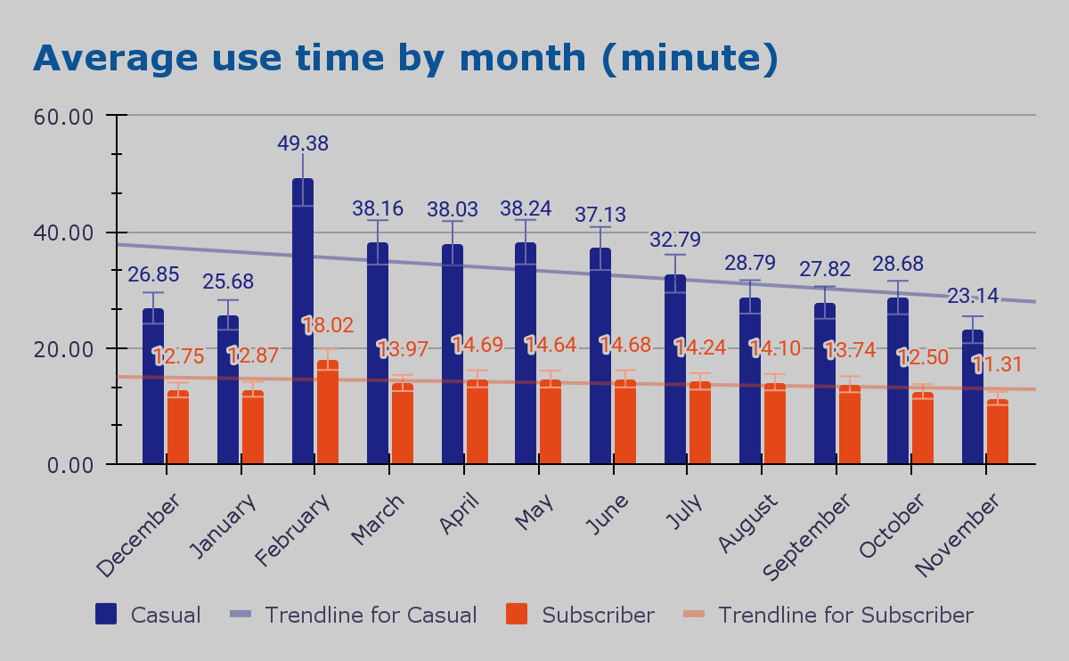
Monthly analysis
Casual customers’ ride lengths are significantly longer.
Subscriber customers’ ride lengths on the weekday are stagnant.
The average time used by the casual customer is 32.8 minutes, subscriber customer is 13.9minutes.

Slide 7
Why February to July have the longest ride length average ?
Why February to July have the longest ride length average ?

Slide 8
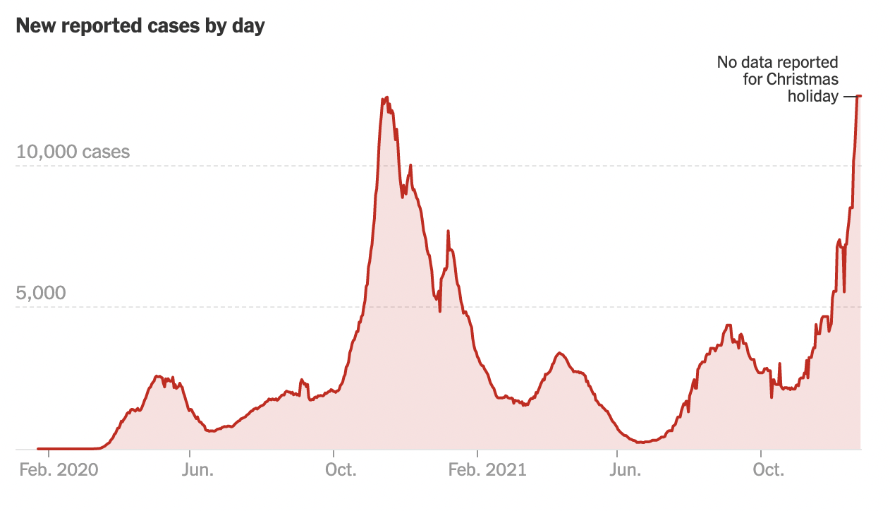
Chicago’s Covid-19 case report in a downtrend
Analysis time frame
*https://www.nytimes.com/interactive/2021/us/illinois-covid-cases.html

Slide 9
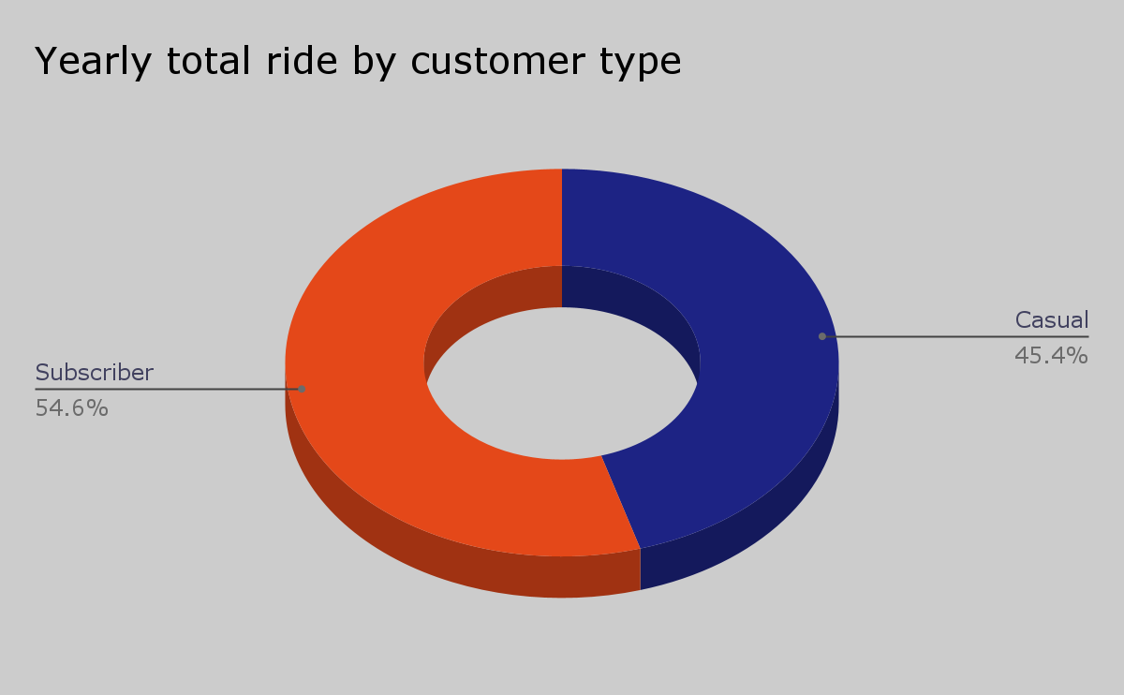
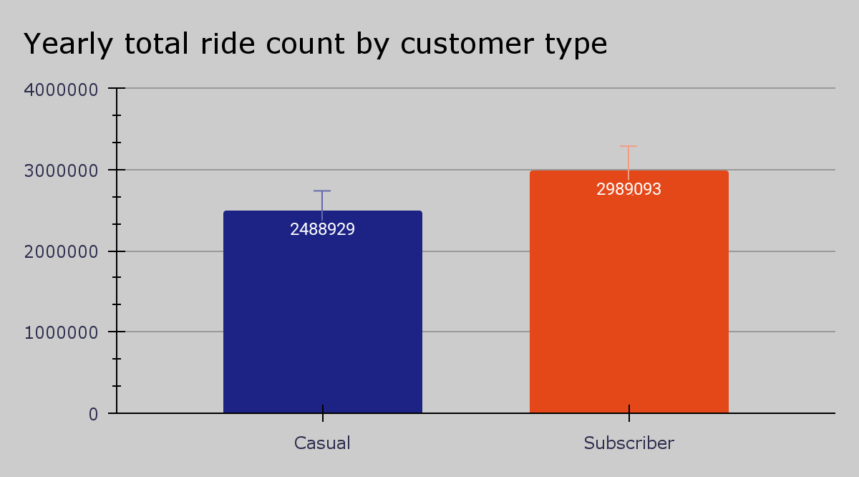
Total ride

Slide 10
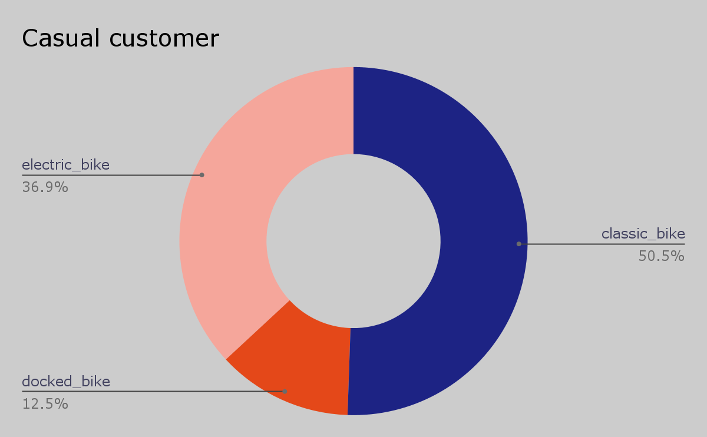
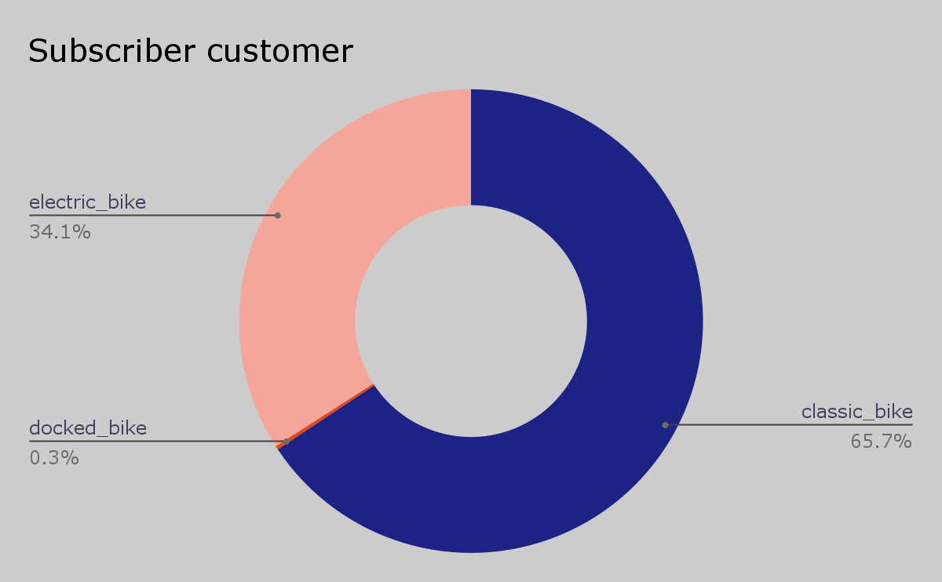
Analysis on rideable type by customer type
Cyclistic offers electric bikes, docked bikes, and classic bikes. The total of casual customers used is 5,478,022 rides (Casual is 2,488,929 rides and subscriber is 2,989,093 rides).

Slide 11
Suggestions

Slide 12
The company should provide a different kind of membership plan that attracts more customer that wants to use the bike in a short period. The limit of subscriber riders is 45 minutes. The average ride length of the subscriber rider is only 13.8 minutes. On the other hand, the average ride length of the casual rider is 31.2 minutes.
The membership plan required the customer to pay $108 upfront. These could be an issue for a customer that earns money daily such as student and daily wage. Therefore, the company can provide a short-term subscription plan for those customers who can effort to pay the current fee.
The company’s marketing strategy should encourage customers to use the docked bike. Usage of docked bikes is very low in both types of customers.

Slide 13
Thank you!

